Slide 1
My Final Project Demo
By Professor Chatterton

Slide 2
This Slide Talks about the following
Executive summary of your project (30s – 1min)
Answer if you were able to complete the project successfully or not.
What is one thing you liked or disliked about the project
If you did not complete the project, what prevented you from finishing?

Slide 3
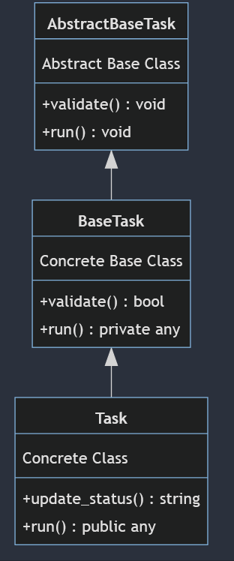
This Slide(s) Talks about the following
super class
Explain your solution with some visuals or code snippets (1-3 minutes)
How did you construct your tasks?
What type of queue did you use and why?
How did you construct your executor/worker?
What Scheduler did you choose and why?
subclass
subclass

Slide 4
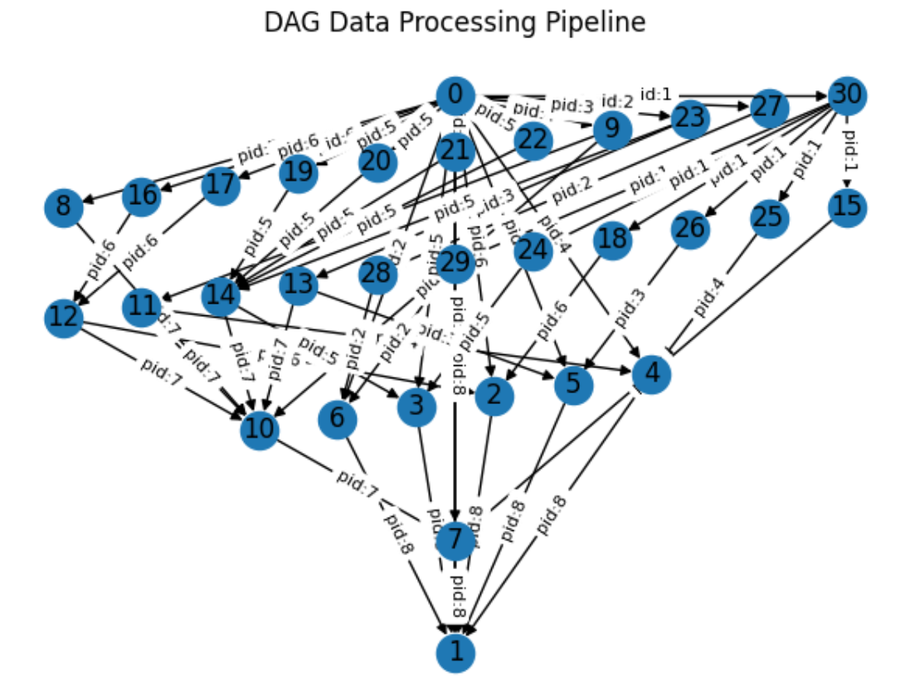
Continuing from the previous slide…
How did you construct your DAG using NetworkX?
What types of checks did you use to make sure your DAG is constructed properly?
What does your DAG Look Like?

Slide 5
This Slide Talks about the following
How could you have made your solution better? (30s)
What are the current limitations you see about how we’ve implemented the final project? (30s)

Slide 6
Thank your audience
Remember, do not overload your slides with a bunch of text that should be used as talking points during your presentation. Keep your slides clean and talk through the points you need to make for your project.

